Slide 1




Basics of infectious disease modelling
MMID Summer School 2025

Slide 2
Lesson 4
Introduction to mathematical modelling
Cameline Orlendo

Slide 3
Learning outcomes
By the end of this lesson, you will be able to:
Explain the role of mathematical modelling in public health
Differentiate between types of models and modeling approaches

Slide 4
Learning outcome one
Understand the role of mathematical modelling in public health

Slide 5

Learning outcomes
By the end of this lesson, you will be able to:
Explain the role of mathematical modelling in public health
understand disease transmission mechanisms
infer important parameters that are hard to observe experimentally
forecast future trends and events
simulate what-if scenarios

Slide 6
Learning outcomes
By the end of this lesson, you will be able to:
Explain the role of mathematical modelling in public health
understand disease transmission mechanisms
key components of contagion (pathogen, host, contact between hosts/vectors) see Adam Kucharski Rules of Contagion; reading material to be sent in advance, group work
[build intuition about what drives transmission]

Slide 7
Learning outcomes
By the end of this lesson, you will be able to:
Explain the role of mathematical modelling in public health
infer important parameters that describe phenomena that are hard to observe experimentally
probability of transmission is hard to observe, why? (flipping, from frequency to probability, mental model of fair coin) - fair infector
relevant physical & biological mechanism (from distance, time of exposure, viral particles, host cell surface to mental model of sigmoid function)
infer relates mental model (i.e. mathematical functions) to parameters

Slide 8
Learning outcomes
By the end of this lesson, you will be able to:
Explain the role of mathematical modelling in public health
forecast future trends and events
from individual events to population-level aggregation
important for outbreak response, hospital planning, drug procurement, insurance
based on current knowledge, what can we say about the near future (i.e. from days to weeks)
example: weather forecast (weather station data, fluid dynamics, historical data, extreme events) for planning (vacation, agriculture, finance), how is disease forecasting different from weather forecasting? with increasing forecasting window, we also are less certain

Slide 9
Learning outcomes
By the end of this lesson, you will be able to:
Explain the role of mathematical modelling in public health
simulate what-if scenarios:
explore hypothetical situations of interest (e.g. counterfactual, what if SARS-CoV-2 would have stayed in Wuhan, ask audience for examples)
retrospective (causal impact)
prospective (compare policy options and make choose between them)
statistical population (stochastic replicates)

Slide 10
Infectious diseases
Phenomenology – Logic - Mathematics

Slide 11
Phenomenology – describing the invisible
Disease phenomenology:
Refers to the observable characteristics, manifestations, and natural history of a disease as it occurs in individuals or populations. It focuses on “what we see happening” with the disease rather than the underlying biological or mechanistic explanation.

Slide 12
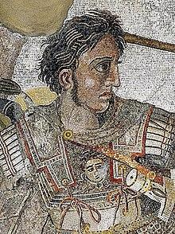
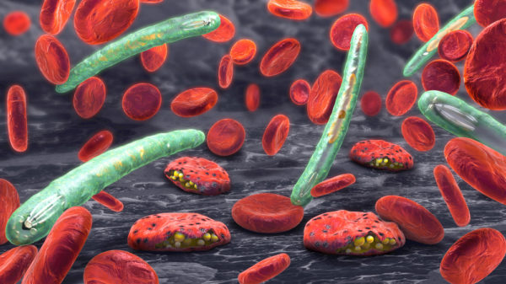
Phenomenology – describing the invisible
Find the name of the pathogen!
Many of the early Greeks thought the disease was contracted by drinking swamp water; later, the Romans attributed it to breathing vapours, arising from bodies of stagnant water.
Encyclopedia Britannica
10000-15000 nm
Alexander the Great

Slide 13
Phenomenology – describing the invisible
Find the name of the pathogen!
Many of the early Greeks thought the disease was contracted by drinking swamp water; later, the Romans attributed it to breathing vapours(mal aria “bad air”), arising from bodies of stagnant water.
Encyclopedia Britannica
10000-15000 nm
Alexander the Great
Plasmodium falciparum sporozoites
(and Red Blood Cells)

Slide 14
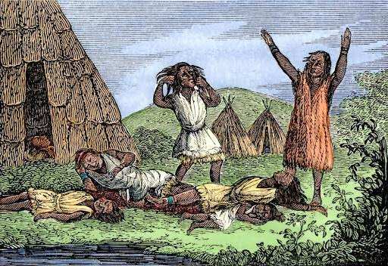

Phenomenology – describing the invisible
Find the name of the pathogen!
Acute infectious disease that begins with a high fever, headache, and back pain and then proceeds to an eruption on the skin that leaves the face and limbs covered with cratered marks.
Encyclopedia Britannica
Native populations
in the Americas
220-450 nm
Notes:
phenomenology of the disease (i.e., how it appears, its observable features as experienced).

Slide 15
Phenomenology – describing the invisible
Find the name of the pathogen!
Acute infectious disease that begins with a high fever, headache, and back pain and then proceeds to an eruption on the skin that leaves the face and limbs covered with cratered marks.
Encyclopedia Britannica
Native populations
in the Americas
220-450 nm
Smallpox virus

Slide 16


Phenomenology – describing the invisible
Find the name of the pathogen!
Transmissible disease of the immune system caused by a virus that slowly attacks and destroys the immune system, the body’s defense against infection, leaving an individual vulnerable to a variety of other infections and certain malignancies that eventually cause death.
Encyclopedia Britannica
Community support
120 nm

Slide 17

Phenomenology – describing the invisible
Find the name of the pathogen!
Transmissible disease of the immune system caused by a virus that slowly attacks and destroys the immune system, the body’s defense against infection, leaving an individual vulnerable to a variety of other infections and certain malignancies that eventually cause death.
Encyclopedia Britannica
120 nm
Earvin Johnson
Human immuno-deficiency virus

Slide 18
Logic – determining the cause
“Robert Koch((1843–1910): Founder of modern bacteriology and the logic of disease causation”
Pioneering German physician–microbiologist; discovered agents of anthrax, TB, and cholera.
Developed key lab methods (pure culture, staining) that shaped modern bacteriology.
Introduced Koch’s Postulates — logical criteria to link microbes to specific diseases.

Slide 19
Logic – determining the cause
For a microogranism to be considered causing a disease, the following must hold: Koch’s postulates (1884)
The microorganism must be found in abundance in all organisms suffering from the disease but should not be found in healthy organisms (Presence).

Slide 20
Logic – determining the cause
For a microogranism to be considered causing a disease, the following must hold: Koch’s postulates (1884)
The microorganism must be found in abundance in all organisms suffering from the disease but should not be found in healthy organisms (Presence).
The microorganism must be isolated from a diseased organism and grown in pure culture (Isolation).

Slide 21
Logic – determining the cause
For a microogranism to be considered causing a disease, the following must hold: Koch’s postulates (1884)
The microorganism must be found in abundance in all organisms suffering from the disease but should not be found in healthy organisms (Presence).
The microorganism must be isolated from a diseased organism and grown in pure culture (Isolation).
The cultured microorganism should cause disease when introduced into a healthy organism (Causation).

Slide 22
Logic – determining the cause
For a microogranism to be considered causing a disease, the following must hold: Koch’s postulates (1884)
The microorganism must be found in abundance in all organisms suffering from the disease but should not be found in healthy organisms (Presence).
The microorganism must be isolated from a diseased organism and grown in pure culture (Isolation).
The cultured microorganism should cause disease when introduced into a healthy organism (Causation).
The microorganism must be re-isolated from the inoculated, diseased experimental host and identified as being identical to the original specific causative agent (Re-isolation).

Slide 23
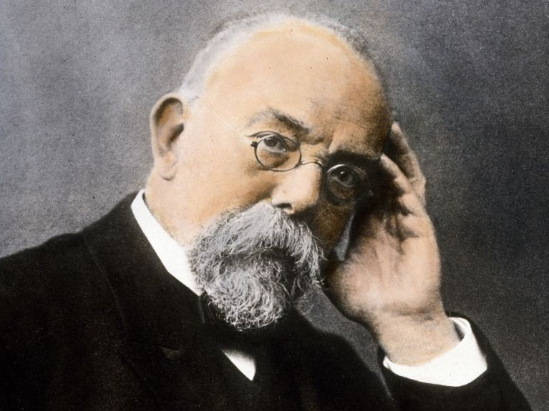
Logic – determining the cause
If I only had known:
Gene sequencing
Transgenic mice
Electron microscopy
Mass spectrometry
Polymerase chain reaction
CRISPR
…
Koch’s postulates in 2025?
Biotechnology

Slide 24
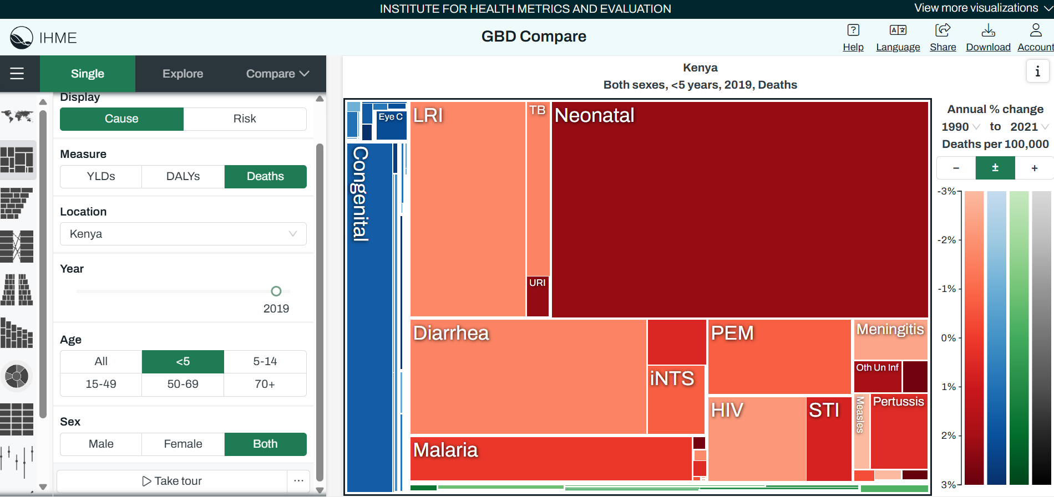
Recap: Measuring disease: Deaths

Slide 25
Recap: Measuring disease: Deaths
Within the redish colors are also communicable diseases.

Slide 26

Measuring disease - Global burden of disease 2019
Explore!
What is the estimated share of communicable disease (in %) in total deaths in Kenya for age under 5 for the year 2019?
How does this percentage change when you consider all ages?
https://vizhub.healthdata.org/gbd-compare/

Slide 27
Measuring disease: Deaths - solution under 5
Notes:
Malaria - 5.76%
Varicella - 0.13%

Slide 28
Measuring disease: Deaths - solution under 5 and All ages
U5 (total) - 42.75% - Diarrhea, LRI, Malaria (main contributors)
All ages (total) - 41.312 - HIV, TB, LRI (main contributors)
Diseases included in both cases: Malaria, Varicella, Measles, Pertussis, Diarrhea, LRI, HIV, STI, Typhi+paratyphi, Meningitis, InTS, TB, (Encephalitis, Acute hepatitis)
Notes:
Malaria - 5.76%
Varicella - 0.13%

Slide 29
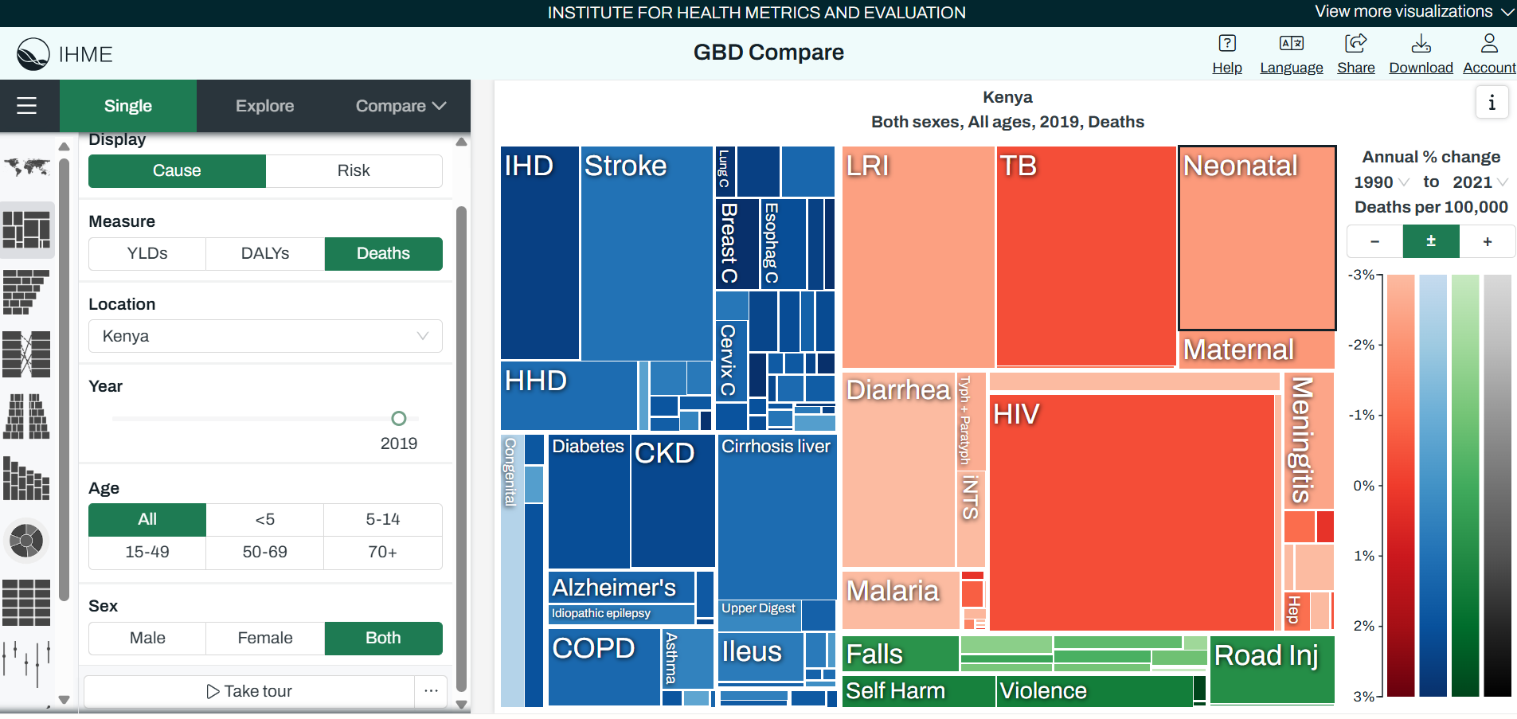
Measuring disease - Global burden of disease 2021
Notes:
Varicella and herpes zoster - 0.047%
Menengitis - 1.17%
Pertussis - 0.28%
Measles - 0.38%
Malaria - 2.99%
Typhoid and Paratyphoid - 0.67%
Invasive non-typhoidal salmonella - 0.49%
Diarrheal diseases - 4.32%
Lower respiratory diseases - 3.94%
COVID19 - 10.87%
Tuberculosis - 4.8%

Slide 30

Measuring disease: DALYs
healthy life until death at age 68
68
life-years without disease
life-years with severe disease sequelae
life-years lost due to disease
life with severe infection at age 7
7
40
21
disability-adjusted life-years (DALYs) averted
due to intervention:
40*0.1+21=25
disability weight = 0.1 corresponds to 10% decrease in economic productivity

Slide 31
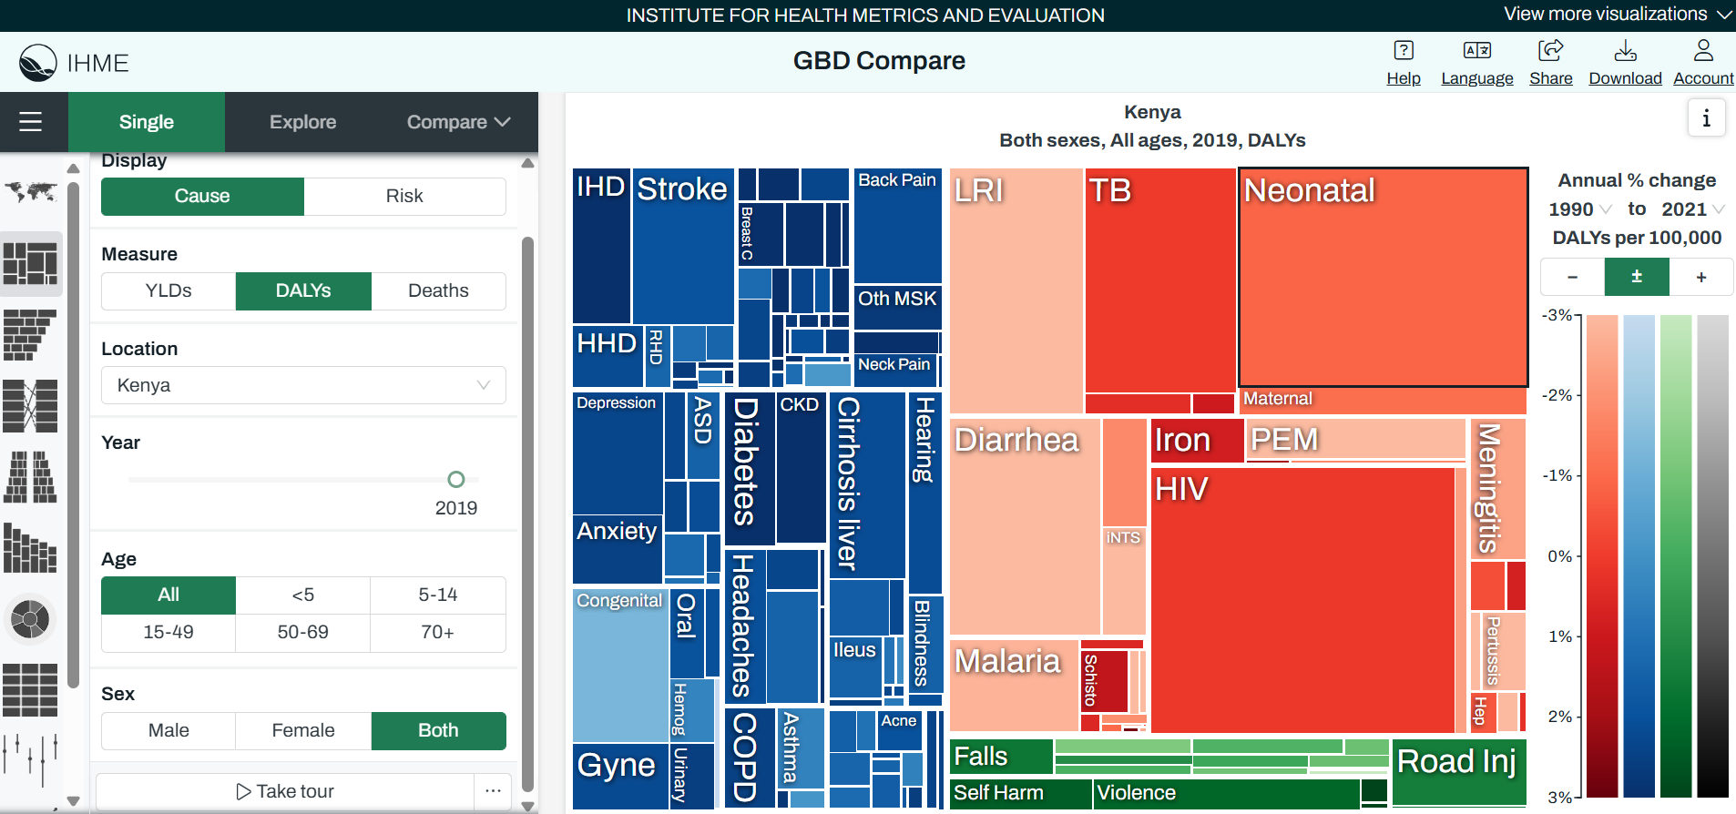
Measuring disease with DALYs

Slide 32
Measuring disease with DALYs
Disability is only minor contributor to DALYs for infection diseases!
It is about death!

Slide 33
Mathematics – inference
Daniel Bernoulli (1760) used mathematics to evaluate the benefits of smallpox inoculation.
He used Hailey`s survival table to compare the life expectancy with vs. without inoculation, showing the potential population-level impact.
One of the first demonstrations of how mathematical inference can inform health policy.

Slide 34
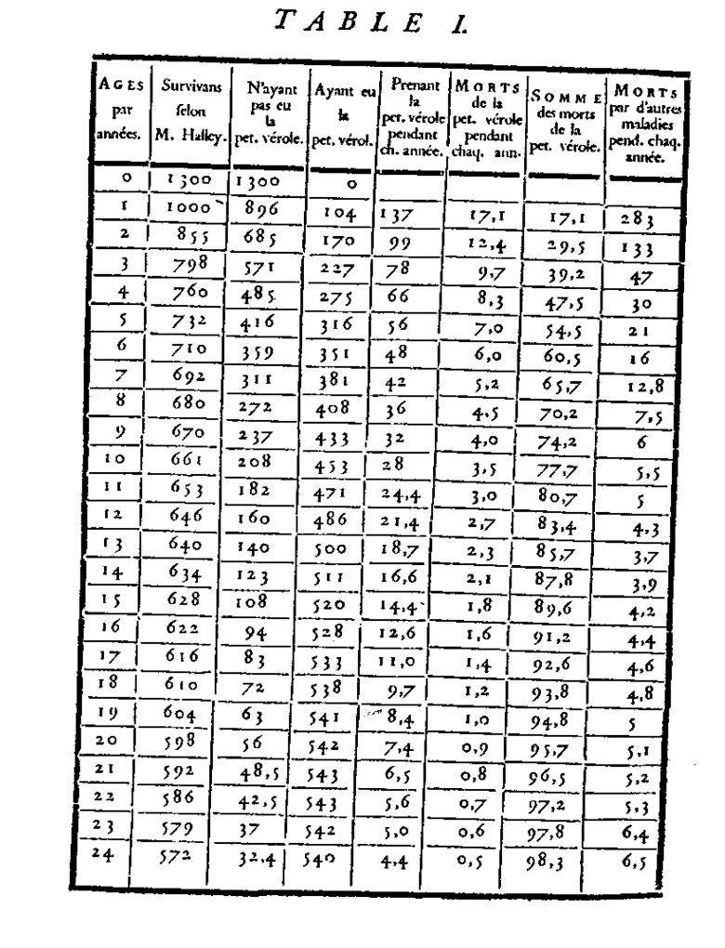
Mathematics – inference
Survival table of a smallpox epidemic in the city of Breslau/Wroclaw in 1693
Bernoulli had some biological parameters:
attack rate=1/8: per capita rate of smallpox infection
virulence=1/8: proportion of infected who would die from smallpox
adverse event rate = 1/200: proportion of people dying from vaccination
Bernoulli, D.: Essai d’une nouvelle analyse de la mortalité causée par la petite vérole et des avantages de l’inoculation pour la prévenir. Hist. Acad. R. Sci. Paris, 1–45 (1760/1766)

Slide 35
Mathematics – inference
Survival table of a smallpox epidemic in the city of Breslau/Wroclaw in 1693
Daniel Bernoulli – smallpox and vaccines
Bernoulli had some biological parameters:
attack rate=1/8: per capita rate of smallpox infection
virulence=1/8: proportion of infected who would die from smallpox
adverse event rate = 1/200: proportion of people dying from vaccination
Bernoulli, D.: Essai d’une nouvelle analyse de la mortalité causée par la petite vérole et des avantages de l’inoculation pour la prévenir. Hist. Acad. R. Sci. Paris, 1–45 (1760/1766)

Slide 36
Mathematics – inference
Daniel Bernoulli – smallpox and vaccines
Bernoulli had only a few data points: « age per year» and « survivors », i.e. age and population size in the cohort
Using differential equations, Bernoulli infers « survivors without smallpox » and from that the population still alive after inoculation (i.e. vaccination)
age | alive_P | susceptible_S | immune_R | alive_Pinoculated | smallpox_deaths
0 | 1300 | 1300 | 0 | 1300 | 17
1 | 1000 | 896 | 104 | 1015 | 12
2 | 855 | 685 | 170 | 879 | 10
3 | 798 | 571 | 227 | 830 | 8
4 | … | … | … | … | …

Slide 37
Mathematics – inference
Daniel Bernoulli – smallpox and vaccines
Bernoulli had only a few data points: « age per year» and « survivors », i.e. age and population size in the cohort
Using differential equations, Bernoulli infers « survivors without smallpox » and from that the population still alive after inoculation (i.e. vaccination)
age | alive_P | susceptible_S | immune_R | alive_Pinoculated | smallpox_deaths
0 | 1300 | 1300 | 0 | 1300 | 17
1 | 1000 | 896 | 104 | 1015 | 12
2 | 855 | 685 | 170 | 879 | 10
3 | 798 | 571 | 227 | 830 | 8
4 | … | … | … | … | …

Slide 38
Mathematics – inference
Daniel Bernoulli – smallpox and vaccines
Bernoulli had only a few data points: « age per year» and « survivors », i.e. age and population size in the cohort
Using differential equations, Bernoulli infers « survivors without smallpox » and from that the population still alive after inoculation (i.e. vaccination)
age | alive_P | susceptible_S | immune_R | alive_Pinoculated | smallpox_deaths
0 | 1300 | 1300 | 0 | 1300 | 17
1 | 1000 | 896 | 104 | 1015 | 12
2 | 855 | 685 | 170 | 879 | 10
3 | 798 | 571 | 227 | 830 | 8
4 | … | … | … | … | …

Slide 39
Mathematics – inference: Practical
Bernoulli assumed a stable population with 1300 births per year, no migration to or from Wroclaw
Using the table smallpox_table.csv, calculate the life expectancy at birth without inoculation (“alive_P”) and with inoculation (“alive_Pinoculated”)
Hint: the probability of being still alive (without inoculation) at age 1: 1000/1300, at age 2: 855/1300, etc.
By how many years does life expectancy at birth increase through inoculation?
age | alive_P | susceptible_S | immune_R | alive_Pinoculated | smallpox_deaths
0 | 1300 | 1300 | 0 | 1300 | 17
1 | 1000 | 896 | 104 | 1015 | 12
2 | 855 | 685 | 170 | 879 | 10
3 | 798 | 571 | 227 | 830 | 8
4 | … | … | … | … | …
read.csv(file = "smallpox_table.csv")->smallpox_table
smallpox_table%>%
select(age,alive_P,alive_Pinoculated,immune_R)%>%
summarize(life_exp_inoculated=sum(alive_Pinoculated)/1300,
life_exp=sum(alive_P)/1300)

Slide 40
Mathematics – inference: Practical
Bernoulli assumed a stable population with 1300 births per year, no migration to or from Wroclaw
Using the table smallpox_table.csv, calculate the life expectancy at birth without inoculation (“alive_P”) and with inoculation (“alive_Pinoculated”)
Hint: the probability of being still alive (without inoculation) at age 1: 1000/1300, at age 2: 855/1300, etc.
By how many years does life expectancy at birth increase through inoculation? 3.07 years
read.csv(file = "smallpox_table.csv")->smallpox_table
smallpox_table%>%
select(age,alive_P,alive_Pinoculated,immune_R)%>%
summarize(life_exp_inoculated=sum(alive_Pinoculated)/1300,
life_exp=sum(alive_P)/1300)
life_exp_inoculated life_exp
30.14692 27.07231

Slide 41
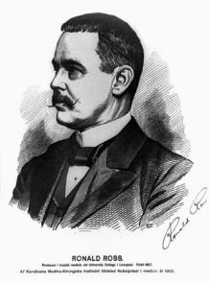
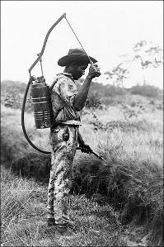
Mathematical modelling for public health decision making is not new!
1916
Remember: It's not necessary to kill all mosquitoes, just to reduce their density.
"To fight malaria, it's not necessary to banish Anopheles completely, it's enough to reduce their numbers below a certain threshold".
Ronald Ross, 1916
Natural history
Start of larvicide campaigns
Source: National Library of Medicine
Koella et al., 1990

Slide 42
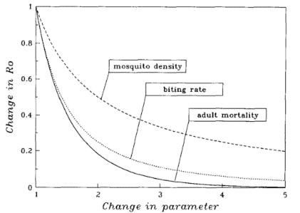
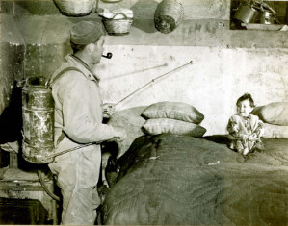
Mathematical modelling for public health decision making is not new!
1916
Remember: It's not necessary to kill all mosquitoes, just to reduce their density.
"To fight malaria, it's not necessary to banish Anopheles completely, it's enough to reduce their numbers below a certain threshold".
Ronald Ross, 1916
Natural history
Start of larvicide campaigns
Source: National Library of Medicine
1956
"This powerful influence of changes in mosquito mortality rates on mosquito-borne disease transmission explains the resounding success of residual insecticides..."
George McDonald, WHO bulletin, 1955
Remember: It's better to increase the mortality of adult mosquitoes than to reduce their density.
IRS is more efficacious than larviciding
Koella et al., 1990
Source: National Museum of Health and Medicine

Slide 43

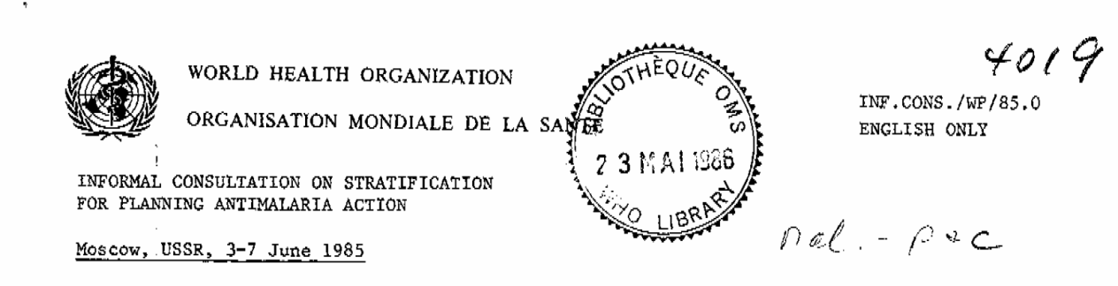
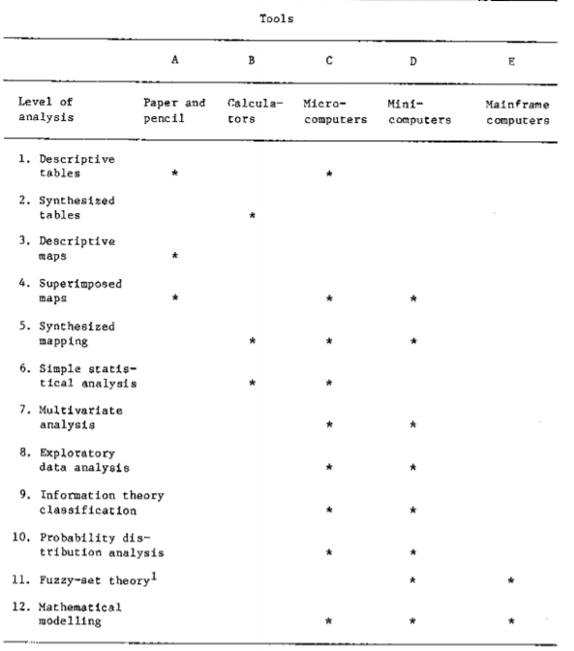

Slide 44
Learning outcome two
Differentiate between types of models and modeling approaches

Slide 45

Courtesy of Thumbi Mwangi (CEMA)

Slide 46

Courtesy of Thumbi Mwangi (CEMA)

Slide 47

Courtesy of Thumbi Mwangi (CEMA)

Slide 48
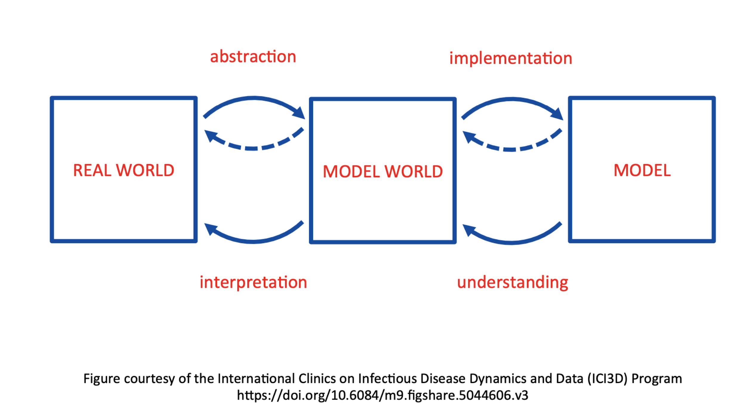
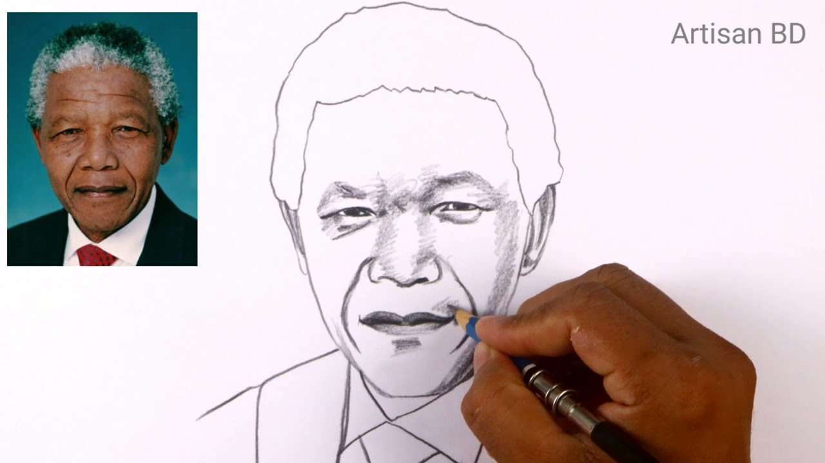
Courtesy of Thumbi Mwangi (CEMA)

Slide 49
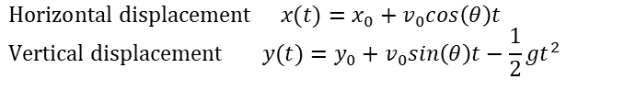
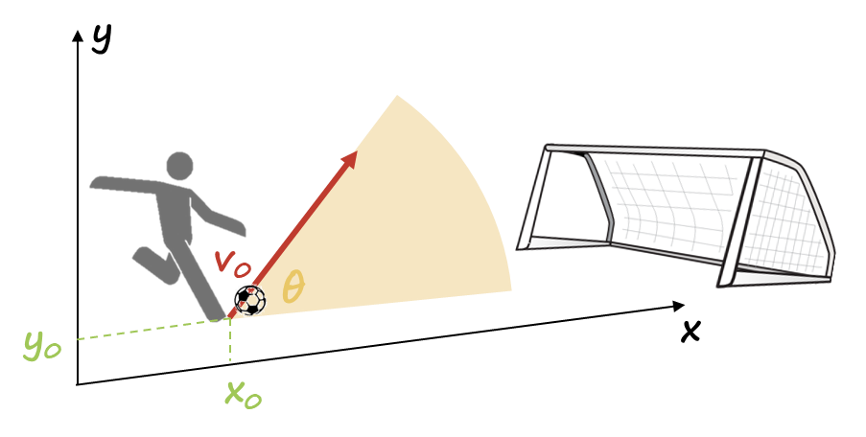

A model is an informative representation of a system
A mathematical model is a theoretical representation of a system using mathematical concepts and language.
MODEL = simplification of the reality
How far/high will the ball go?
How long will it take to reach the goal?
…
✓
Which leg should the player hit the ball with? Will the goalkeeper catch it?
✗
Parameters
Predictions

Slide 50
A model is an informative representation of a system
A mathematical model is a theoretical representation of a system using mathematical concepts and language.
MODEL = simplification of the reality
How far/high will the ball go?
How long will it take to reach the goal?
…
✓
Which leg should the player hit the ball with? Will the goalkeeper catch it?
✗
Parameters
Predictions

Slide 51
A model is an informative representation of a system
A mathematical model is a theoretical representation of a system using mathematical concepts and language.
MODEL = simplification of the reality
How far/high will the ball go?
How long will it take to reach the goal?
…
✓
Which leg should the player hit the ball with? Will the goalkeeper catch it?
✗
Parameters
Predictions

Slide 52
A model is an informative representation of a system
A mathematical model is a theoretical representation of a system using mathematical concepts and language.
MODEL = simplification of the reality
How far/high will the ball go?
How long will it take to reach the goal?
…
✓
Which leg should the player hit the ball with? Will the goalkeeper catch it?
✗
Parameters
Predictions

Slide 53
They help us to think rationally and can help generate evidence in our decision-making process.
"All models are wrong, some are useful"
According to George Box
They never represent the exact reality

Slide 54
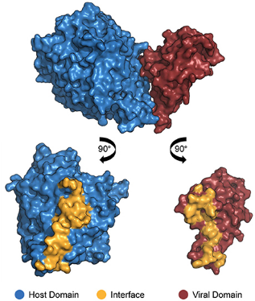
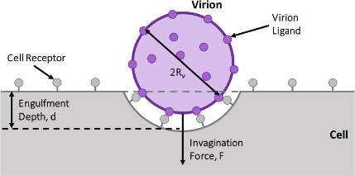
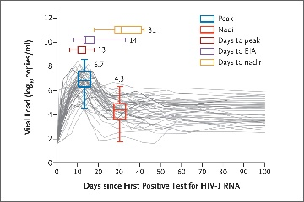
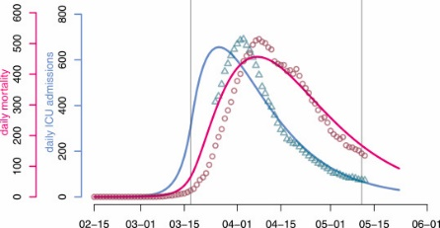
Mathematical models in infectious diseases
Molecular: How do pathogen proteins interact with host proteins?
Biophysical: How does a pathogen enter a host cell?
Intra-host: How does the pathogen population evolve in the body of the host?
Population- and individual-level: How does the population (individuals) of infected hosts evolve?

Slide 55
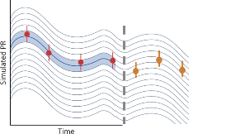
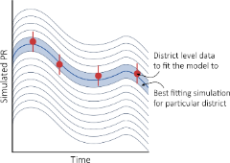
Mathematical modeling = process of building models
Identify question: When does the epidemic peak?
Formalize question: Which compartments and transitions should be considered?
Test your model: Does it do what it is supposed to do?
Parameterize: What are plausible values for your parameters?
Inference: Confront you model with data! Draw conclusions on parameter values!

Slide 56
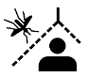




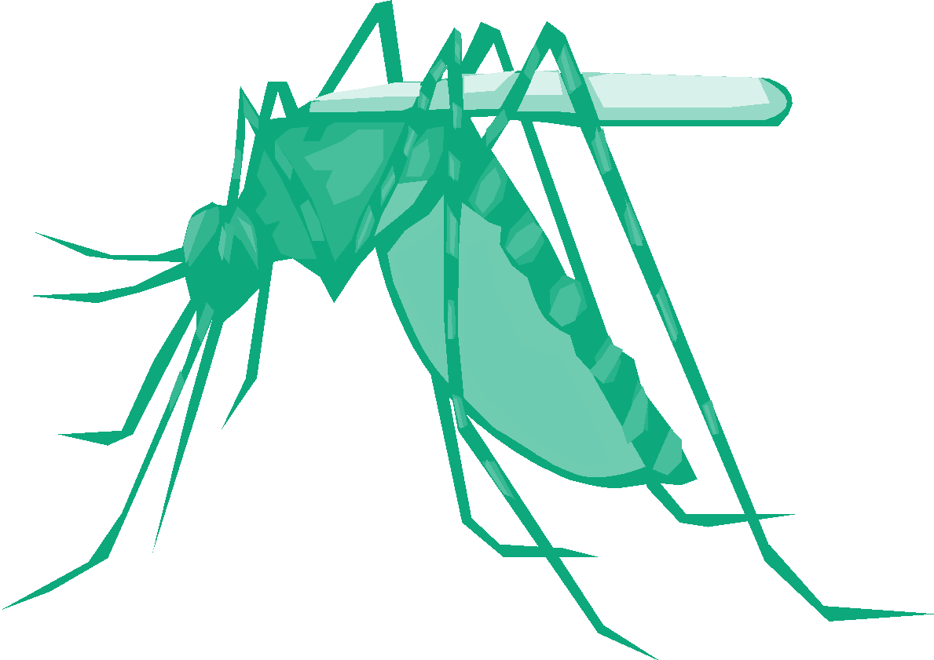
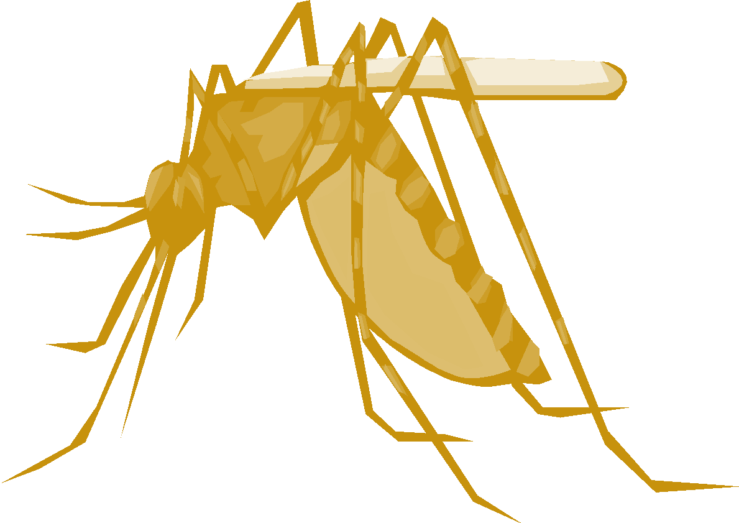
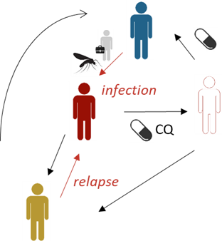



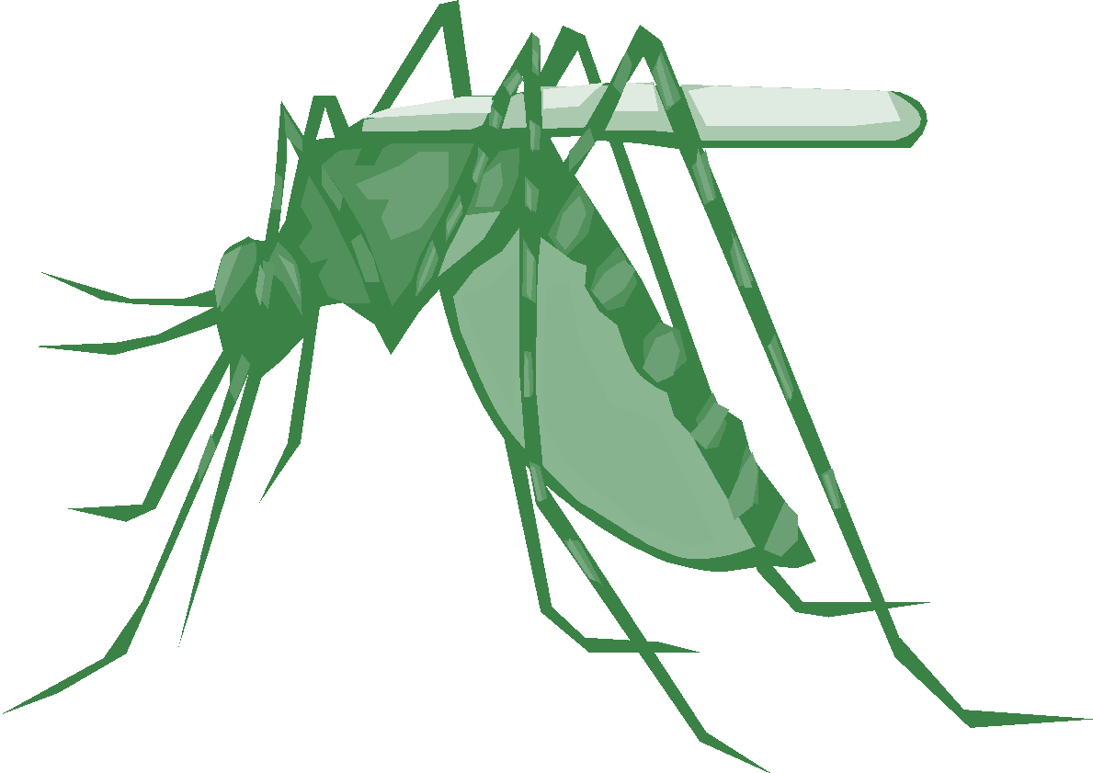
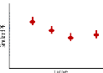





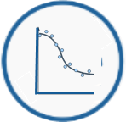
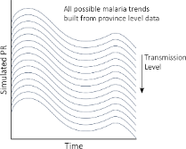



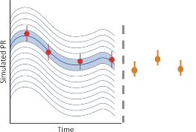
Mathematical modeling = process of building models
Identify the model (construct/understand the model structure)
+
1. Understand the question and choose the appropriate model
2. Gather the necessary data
3. Calibrate the model
6. Discuss results
Iterate!
4. Validate the model
5. Use the model to answer the question
Notes:
Beore I conclude, I would like to emphasize on the role of the close collaboration with National Malaria Control programs. None of the work in Tanzania would have been possible without the program understanding the utility of modelling and the modellers understanding the context and the questions. It takes time and many many iterations but the process is more likely to be successful when we have partners on the ground dedicated to coordinate the modelling activities and supporting it by relaying relevant information to the modellers, helping to refine the questions, collate & chase the data but also provide support for the understanding and interpretations of the outputs.
Local Partners:
Support the definition of the questions
Refine analyses
Collate data
Manage expectations
Translate analyses
Support level of understanding
Ensure appropriate use of evidence

Slide 57

Mathematical modeling, more a craft than a science
Specific skills you do not necessarily learn in a lecture
hands-on: tap into available resources to solve problems, there is no «deep» theory of infectious disease mathematics
interdisciplinary : understand the data creation process by talking to microbiologists, epidemiologists, bioinformaticians
communication: align with interests of your non-technical partners and communicate results effectively

Slide 58


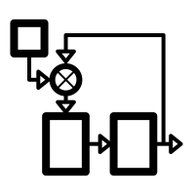

Modeling = a process where people from different worlds meet on a common ground
biologist/epidemiologist/entomologists:
translate biological and population-level observations into flow diagrams
mathematician:
translates flow diagrams into equations
software engineer/computer science:
translates equations into computer code
Notes:
Explain multidisciplinary nature of modeling as a process

Slide 59






Statistical vs mathematical modelling
Statistical models
Mechanistic models
Initial speed
Angle
Initial position
Measurements / Data
Predictions
Model parameters
Predictions
Requirements | Observed data | Understanding of the mechanism that drives the system
Example of useful applications | Malaria risk mapping | Malaria transmission models (=dynamical models)

Slide 60
Statistical vs mechanistic modelling
Mechanistic model
With the mathematical model, we can explore counterfactual scenarios, i.e. What would happen if we …
Initial speed
Angle
Initial position
Model parameters
Predictions
Initial speed
Angle
Initial speed
Angle
Initial position
Initial position

Slide 61
Lecture 4, practical: Kucharski, The rules of contagion, chapter 1
Group discussion and submit a short written report
Groups (1, 2 & 3)
Groups (4, 5 & 6)
Which emerging infectious disease does the author mention in the beginning of the chapter?
Are there any other infectious disease outbreak in the past ten years that you heard of?
Which transmission route for malaria did Ross test first? Which one of Koch’s postulate did his experiment try to confirm?
Which malaria control method did Ross experiment that proved to be effective?
Explain how Ross concluded that it was not crucial to eliminate all mosquitoes in order to eliminate malaria!
Ross adopted a mechanistic approach to understand. Explain how this was different from the descriptive approaches most common at the time!
Name the two other heroes of infectious disease modeling, and their technical approach.
Explain in your own words the S-shaped curve and how it relates to the dynamics of contagion!

Slide 62
Key takeaway points:
The use of mathematical modelling for public health decision making is not new!
ratio between vector and host population can switch between two distinct quantitative infection dynamics (extinction vs endemicity)
vector control modeled as increased vector mortality allows to link entomological parameters to infection outcomes in humans

Slide 63

Acknowledgements
Christian Selinger
Emilie Pothin
Billy Bauzille
Zenabu Suboi
Geoffrey Githinji
Asanteni sana
Cameline.Orlendo@swisstph.ch

